Slide 1
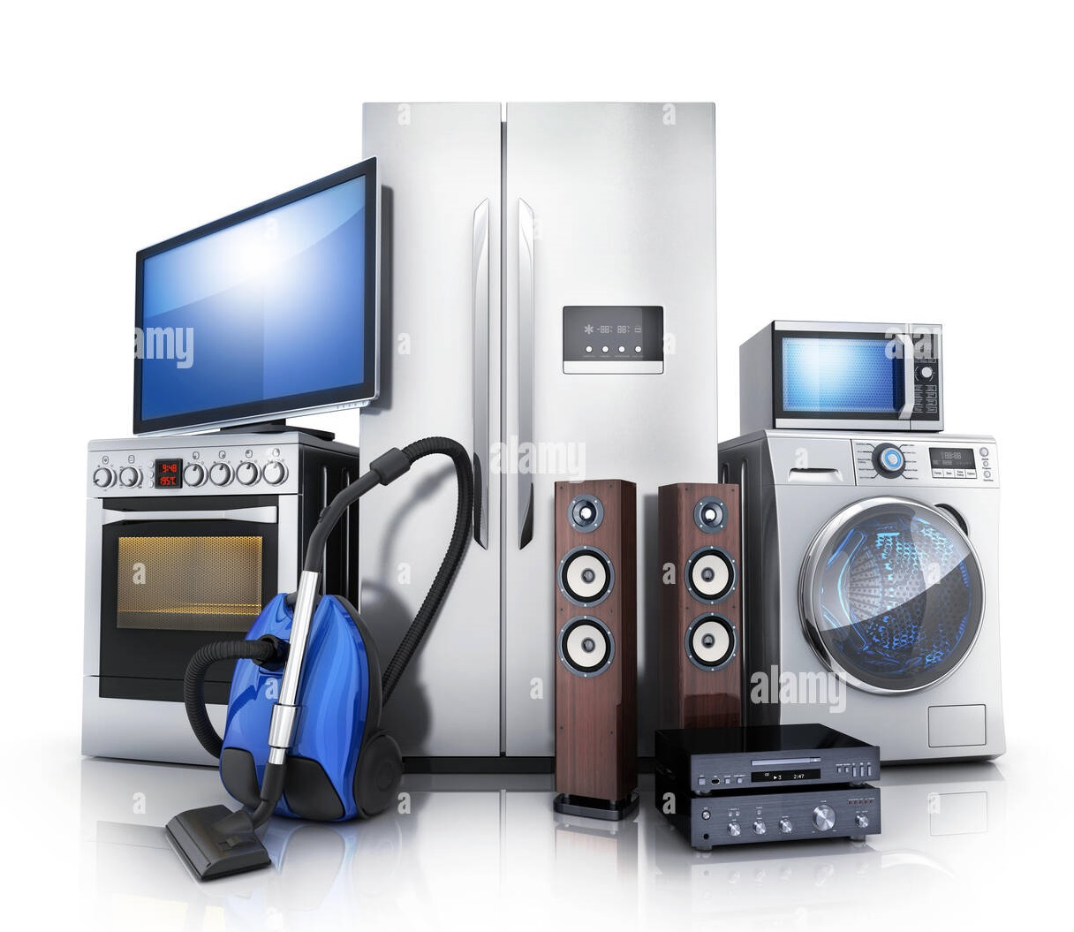
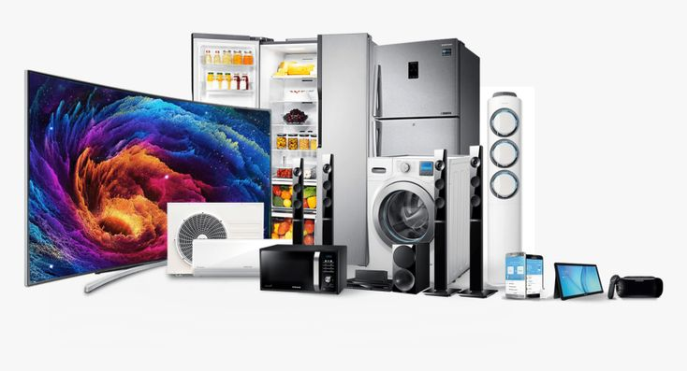
GLOBAL ELECTRONICS
Analysis of INSIGHTS

Slide 2
INTRODUCTION
In this PowerPoint Presentation Contains Visually Compelling Visualizations and Actionable Recommendations To Tailored The Marketing Strategies,
Improve the Sales Increasing, Guide Product Development, Inform Store Expansion and Operational Decisions.
This Analysis will Empower Global Electronics to increase Customer satisfaction, drive overall business growth, Maximize Revenue

Slide 3

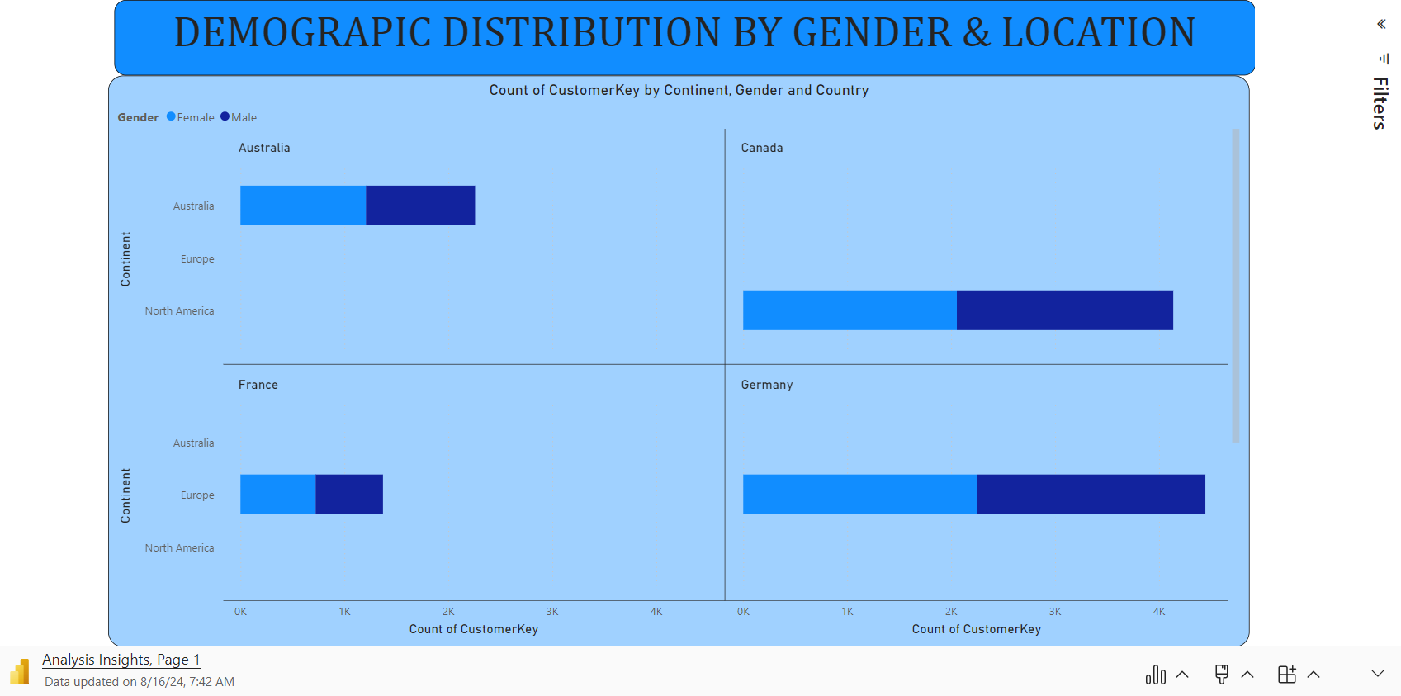
Microsoft Power BI

Slide 4
ANALYSIS & SOLUTION
ANALYSIS
Solution
The previous slide indicates the number of customers we have around the world.
We analyzed data by country, continent, and gender to determine where we have the most customers, both male and female.
The results show that the number of male and female customers is almost the same.
We predict that countries like the US, UK, Germany and Australia have a large number of customers.
To retain these customers, we are offering them specific benefits.
In countries with fewer customers, we will announce targeted promotions such as discounts, vouchers, etc.
These discounts will be tailored individually based on the customer's gender.

Slide 5
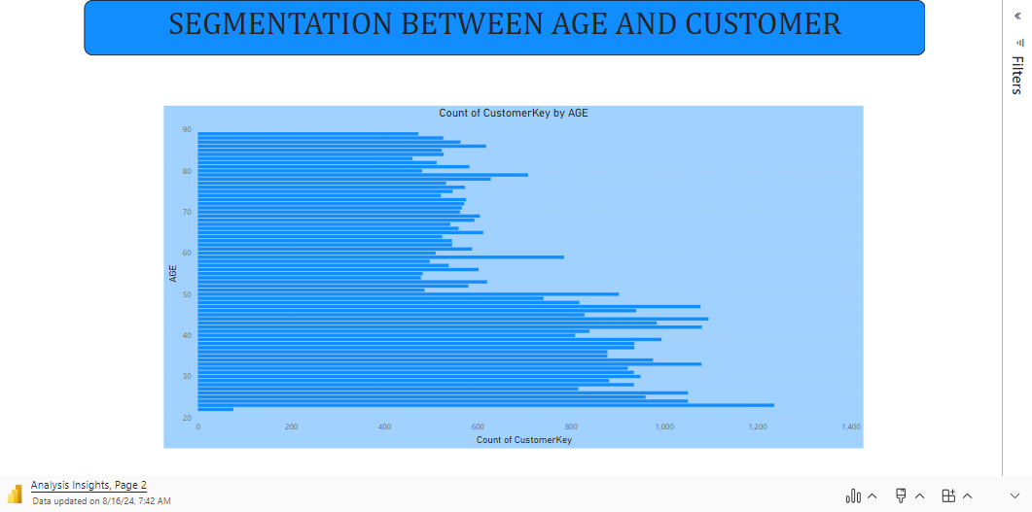
Microsoft Power BI

Slide 6
ANALYSIS & SOLUTION
ANALYSIS
Solution
The above slide indicates the predicted age groups of our customers.
We identified which age group has the most customers.
The age was calculated from the birthday column.
The majority of customers are between the ages of 20 and 50, while the fewest are above 50.
First, we analyzed the sales and product statistics for these age groups.
For the age group with the most customers, we will increase production and offer extra coupons, which can be redeemed exclusively with us.
For the age group with fewer customers, we will focus on increasing the products they need and provide additional vouchers based on their sales level.

Slide 7
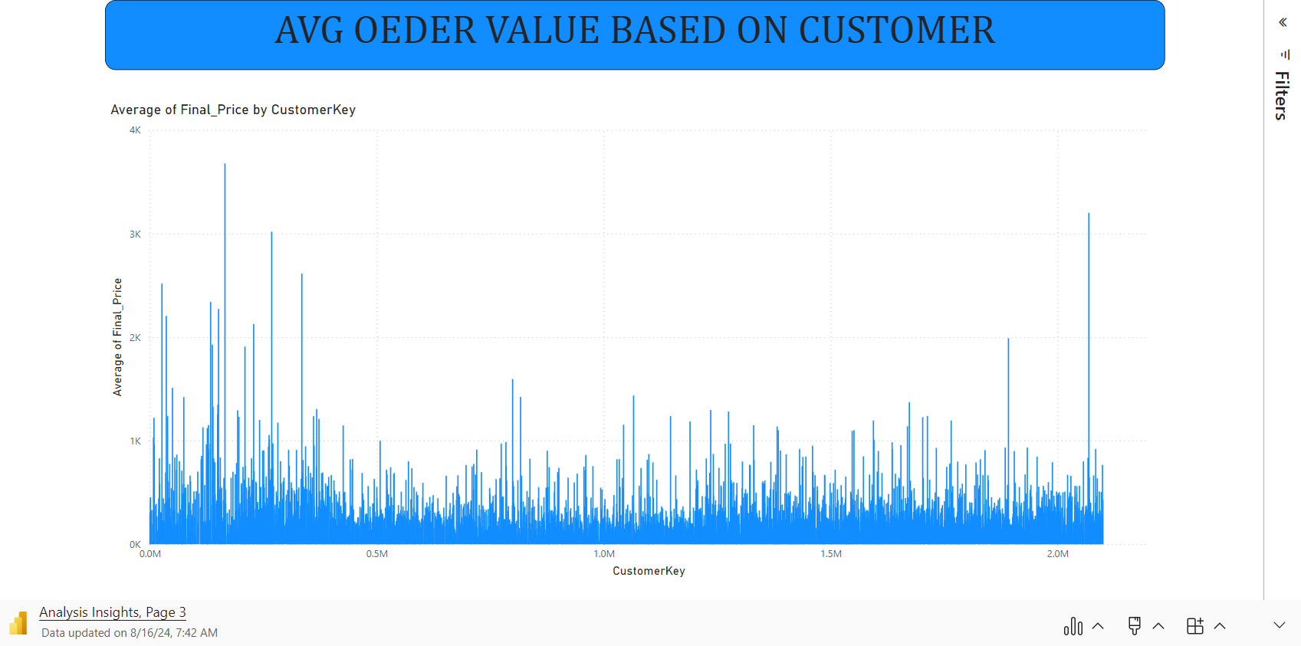
Microsoft Power BI

Slide 8
ANALYSIS & SOLUTION
ANALYSIS
Solution
The above slide indicates the average order value per customer.
We predict the final price by multiplying the unit price in USD by the exchange rate.
In this case, we can identify our loyal customers.
We will announce a loyalty program for all customers.
This program will use a points-based system where customers earn and redeem points.
When customers make a purchase, they will earn certain points.
They can then use these points to redeem for future purchases.

Slide 9
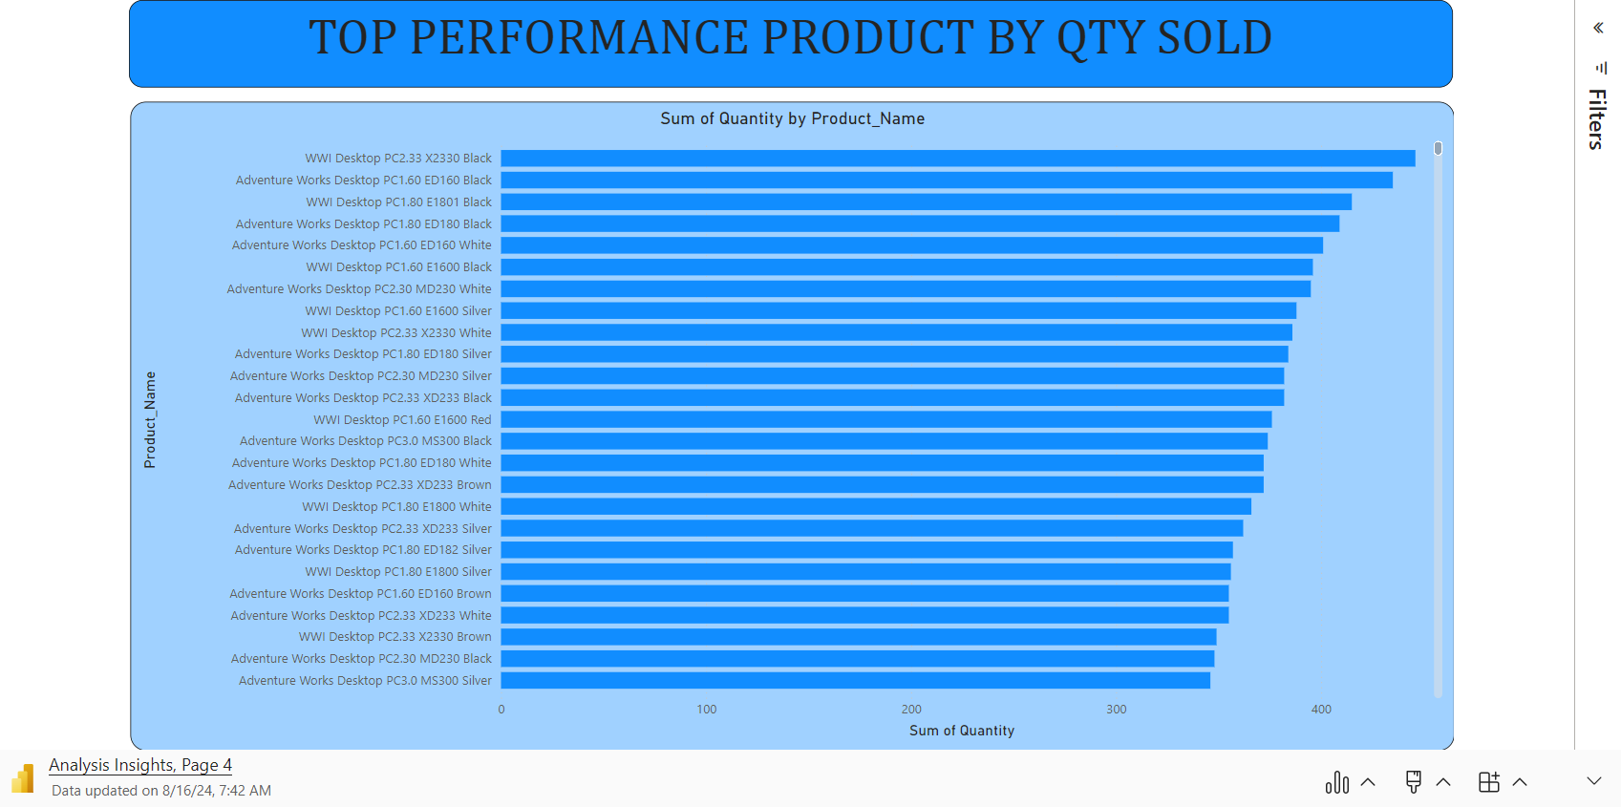
Microsoft Power BI

Slide 10
ANALYSIS & SOLUTION
ANALYSIS
Solution
The above slides indicate the products sold in the highest quantities.
For the analysis, we considered the product names and the total quantity sold for each product.
Our top-performing products include desktops, DVD players, and headphones.
The lower-performing products are printers, cameras, microwaves, and refrigerators.
We will focus on low-performing products because they are electronic items.
We will regularly purchase top-selling products from our wholesaler.
For low-selling products, we will only buy them when we receive an order from a customer.
This approach will help us manage losses and prevent damage to products.

Slide 11
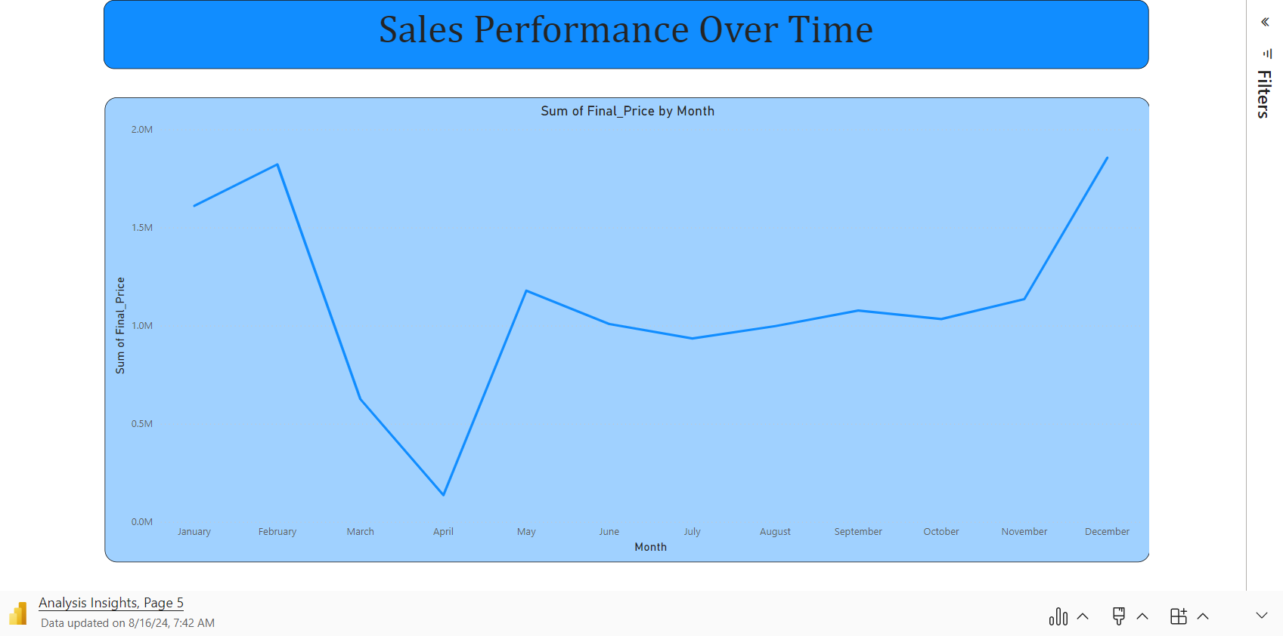
Microsoft Power BI

Slide 12
ANALYSIS & SOLUTION
ANALYSIS
Solution
The above slide indicates the months when our sales reach high levels.
We analyzed the order date and the total final price for each month.
Sales are at their peak from December to February, average from May to November, and significantly lower in March and April compared to other months.
In March and April, our focus is on production, employees, and customers.
During these months, we halt recruitment, and if employees want to take vacations, we approve them.
In the months with average sales levels, we increase offers and discounts, and promote our loyalty program.

Slide 13
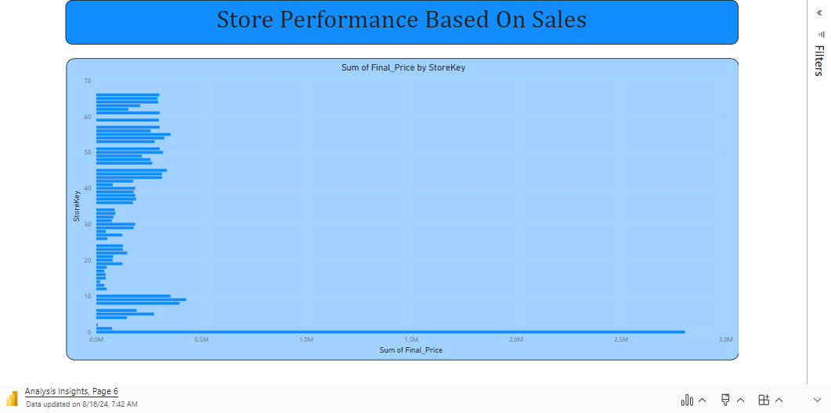
Microsoft Power BI

Slide 14
ANALYSIS & SOLUTION
ANALYSIS
Solution
The above slides indicate store expansion based on total sales.
For this analysis, we considered the store key and the total sales amount.
We found that only one store had significantly higher sales, while the rest were considered low or normal in comparison.
In this case, we first focus on low and normal-level stores.
If we have multiple stores in the same location, we will keep only one store and stop sales at the others to maintain profit levels.
For high-level stores, we will not make any changes unless we need to add extra stores, and even then, it will depend on the profit level.

Slide 15
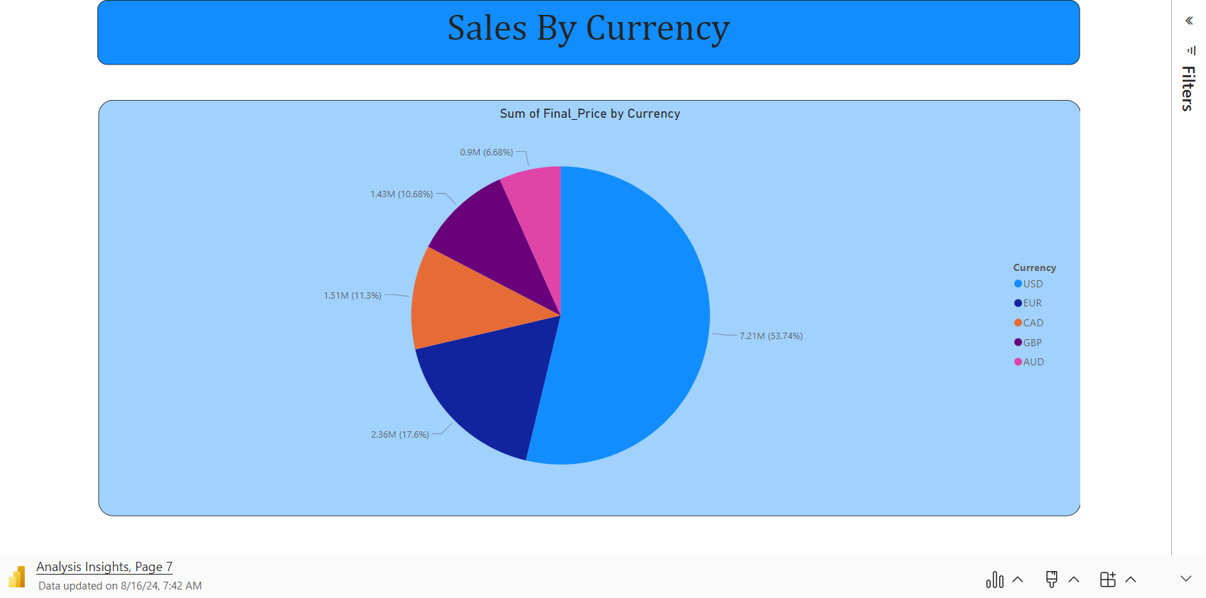
Microsoft Power BI

Slide 16
ANALYSIS & SOLUTION
ANALYSIS
Solution
The above slides indicate the total amount of sales based on currency value.
For this analysis, we considered the total sales amount and the currency.
We can easily predict where the sales ratios are high, low & medium.
We will focus on all currency values except USD, as we are a US-based company.
We will analyze which days of the month see higher and normal currency values and announce special offers during those times.
Our main focus will be on AUD and GBP.

Slide 17
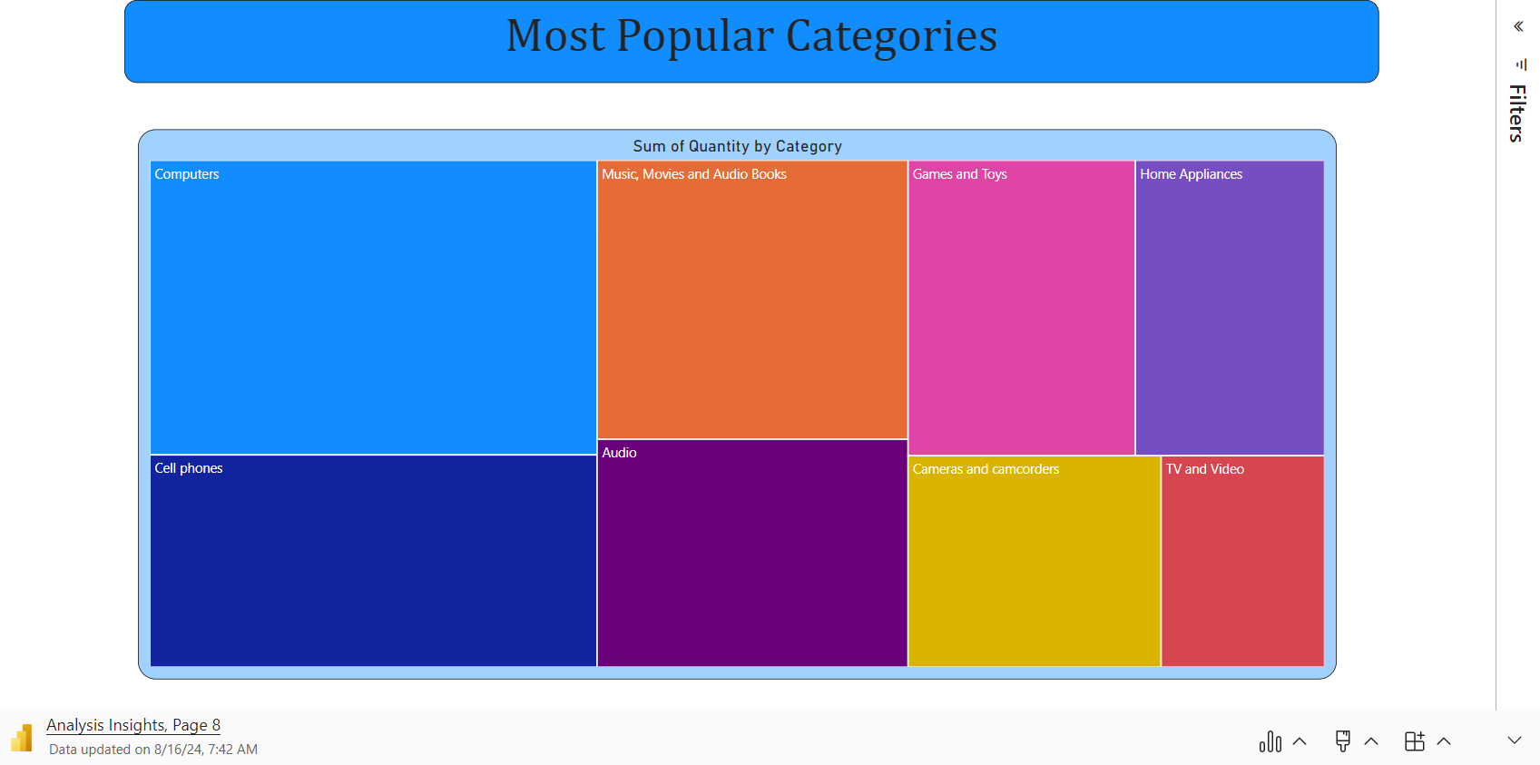
Microsoft Power BI

Slide 18
ANALYSIS & SOLUTION
ANALYSIS
Solution
The above slide indicates which category of items sold the largest number of units.
For this analysis, we considered item categories and the total quantity sold.
We can easily identify which categories have low and high sales based on quantity.
We will primarily focus on categories with low quantities sold.
In this case, we will control the orders from our wholesaler.
We will purchase items from our wholesaler only when we receive orders from customers.
In our warehouse, we will store only the top-selling categories, while low-quantity categories will be stocked based on customer demand.

Slide 19
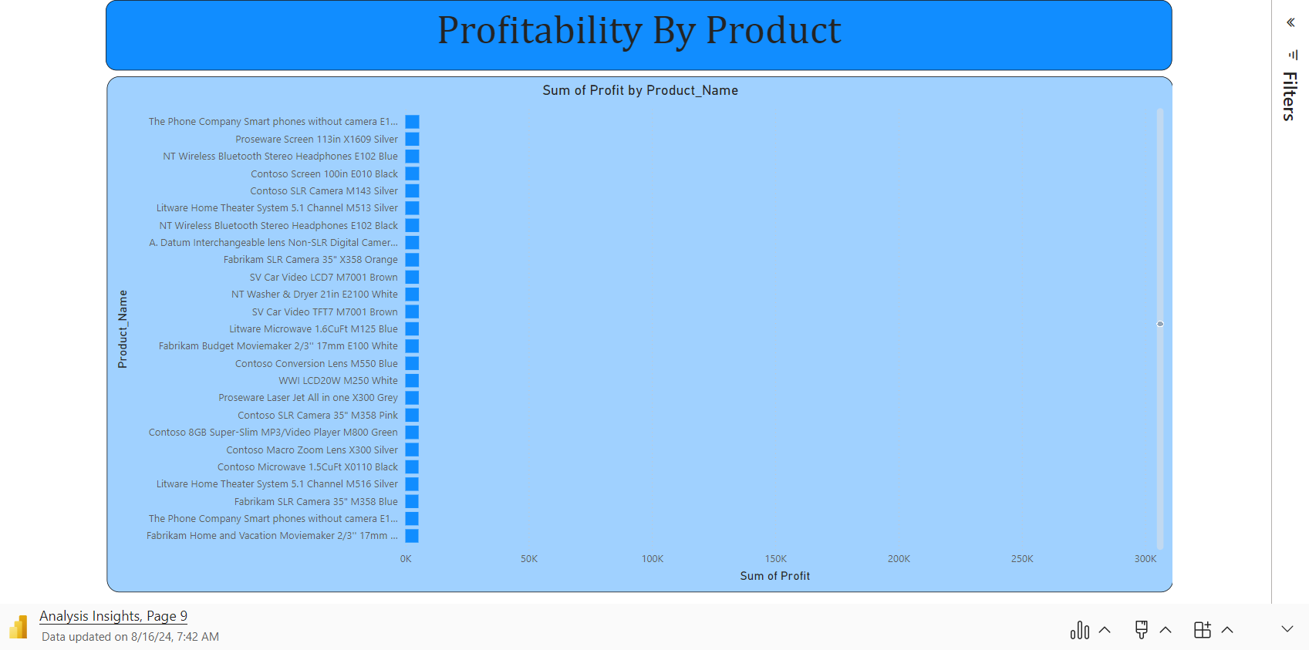
Microsoft Power BI

Slide 20
ANALYSIS & SOLUTION
ANALYSIS
Solution
The above slide indicates the profit level of our individual products.
For this analysis, we considered the product names and calculated the total amount of profit.
Computers, LCDs, and water heaters provided high profits, while cameras, microwaves, and refrigerators yielded lower profits.
The remaining products generated medium profits.
First, we will focus on products with low profit levels, purchasing only limited stocks from our wholesaler to avoid overstocking.
For high-profit products, we will maintain a consistent stock in our warehouse to ensure we never run out.
For products with medium profit levels, we will keep an average stock level sufficient to meet demand.

Slide 21
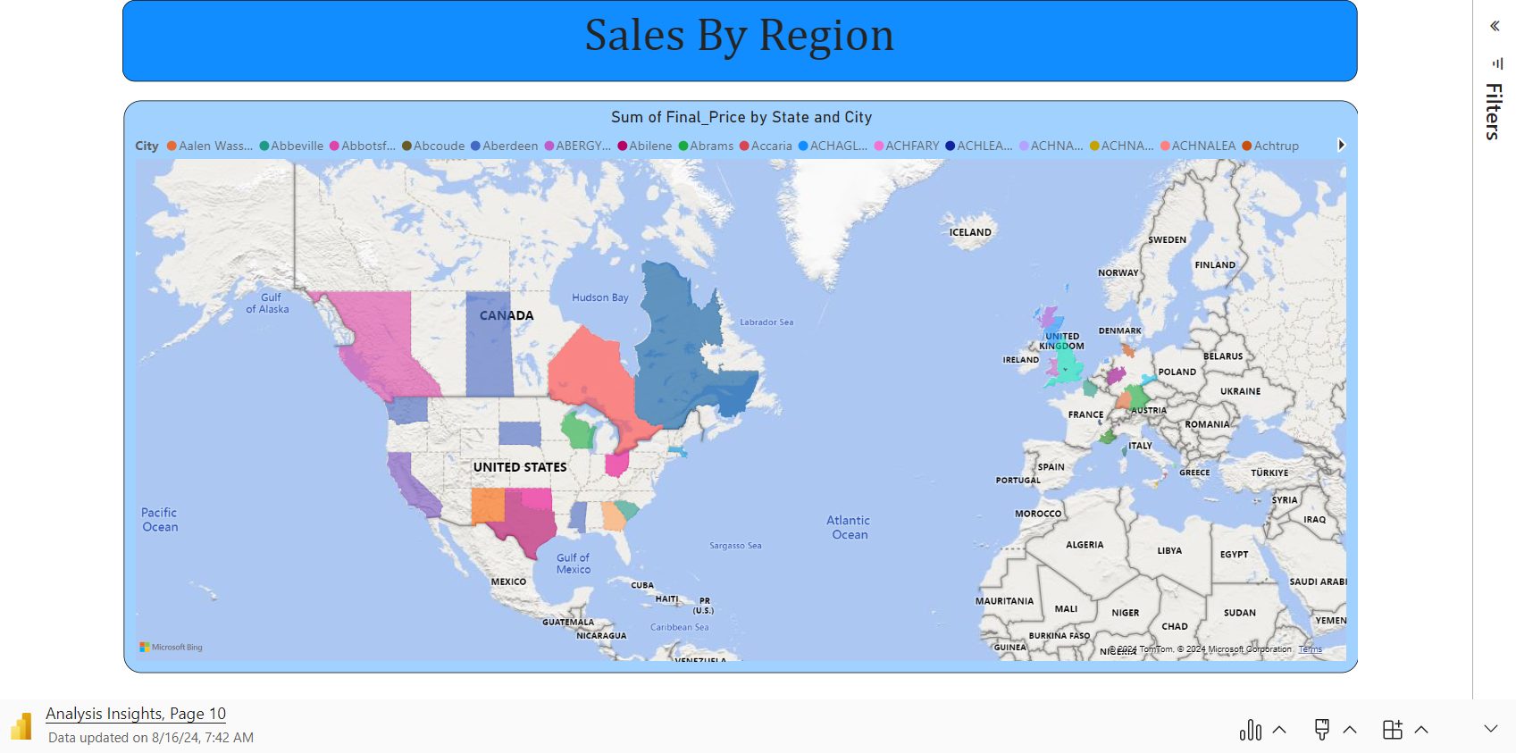
Microsoft Power BI

Slide 22
ANALYSIS & SOLUTION
ANALYSIS
Solution
The above slide indicates the total amount of sales in each state and city.
For this analysis, we considered the state, city, and the sum of the final price.
Sales are highest in the US and Canada.
In comparison, European countries have smaller sales amounts compared to the US and Canada.
Our company is US-based, so our sales are naturally higher in these regions.
For European countries, we plan to establish branches in the UK and France to boost sales.
Alternatively, we will launch extra offers, discounts, and vouchers to increase sales in these areas.

Slide 23
CONCLUSION
This presentation has outlined a series of data-driven insights and actionable recommendations tailored to enhance the marketing strategies, boost sales, guide product development, and inform store expansion and operational decisions for Global Electronics.
By implementing these strategies, Global Electronics can:
Increase Customer Satisfaction: Tailored marketing strategies and product offerings will resonate better with customer preferences, leading to higher satisfaction and loyalty.
Drive Overall Business Growth: Informed decisions based on the analysis will lead to more effective marketing campaigns, optimized product development, and strategic store expansions, all contributing to sustainable business growth.
Maximize Revenue: By focusing on the right customer segments, refining product offerings, and optimizing store locations, Global Electronics can unlock new revenue streams and improve profitability.
These steps will position Global Electronics to thrive in a competitive market, ensuring continued success and expansion.

Slide 24


